Slide 1
Reaching a changed consumer:
Telling the right story with your menu
October 2020

Slide 2
TAKING CARE OF THE ENVIRONMENT

Slide 4
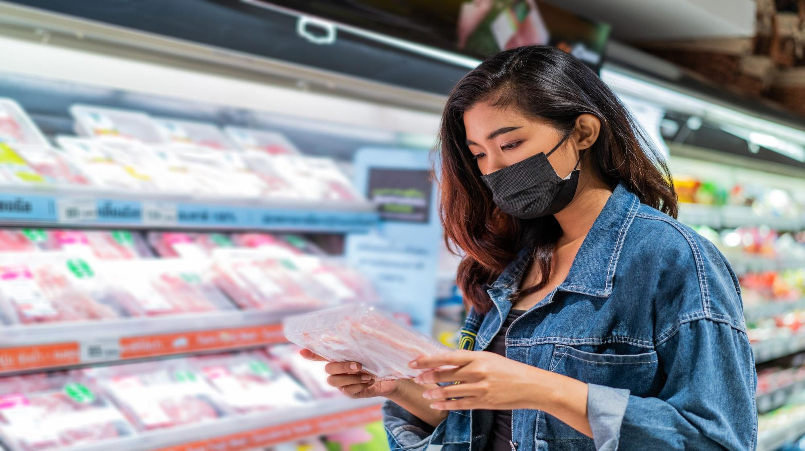
+56%
boost in dollar sales for CPG companies promoting sustainability efforts (pre-pandemic)
Notes:
Smartbrief 9.9.2020

Slide 5
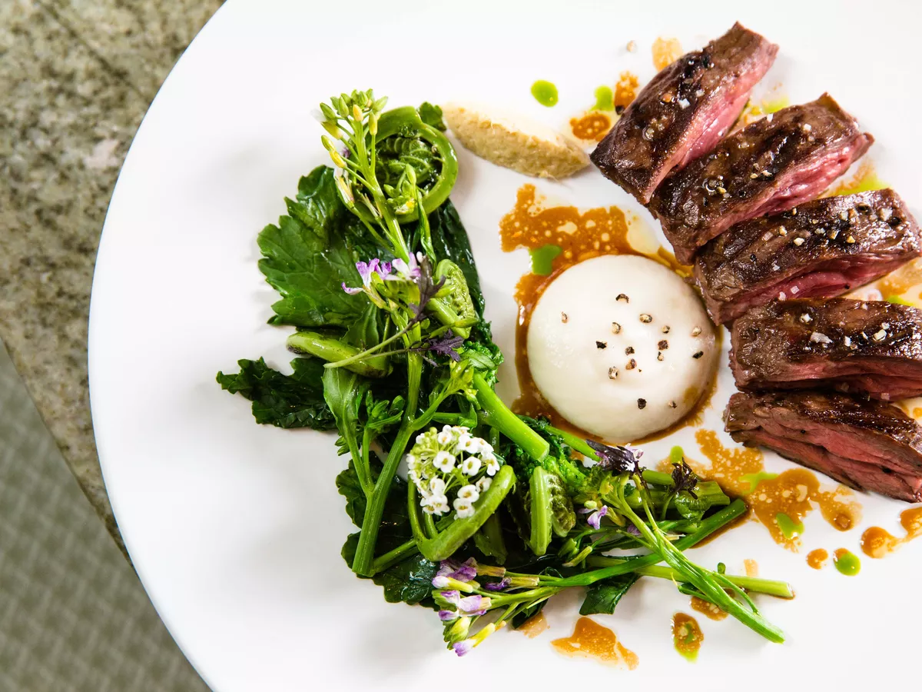
50%
Of consumers were more likely to make a restaurant choice based on eco-friendly practices (pre-covid)
Notes:
NRA State of Restaurant Sustainability Report 2018

Slide 7
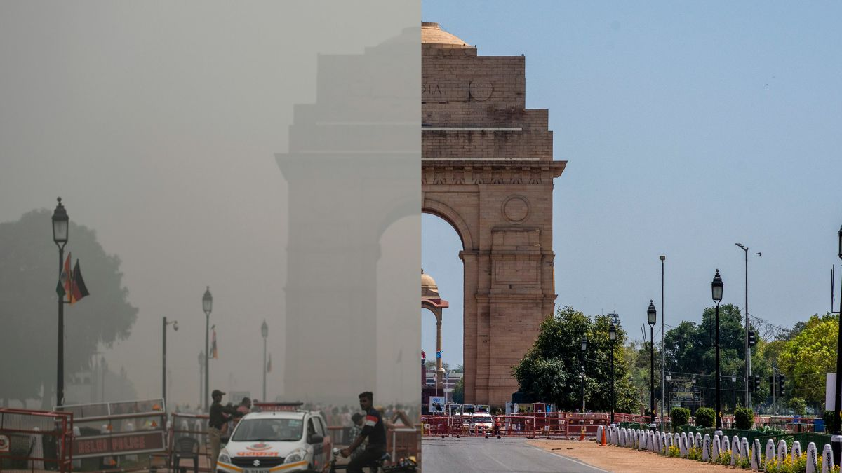

Slide 8
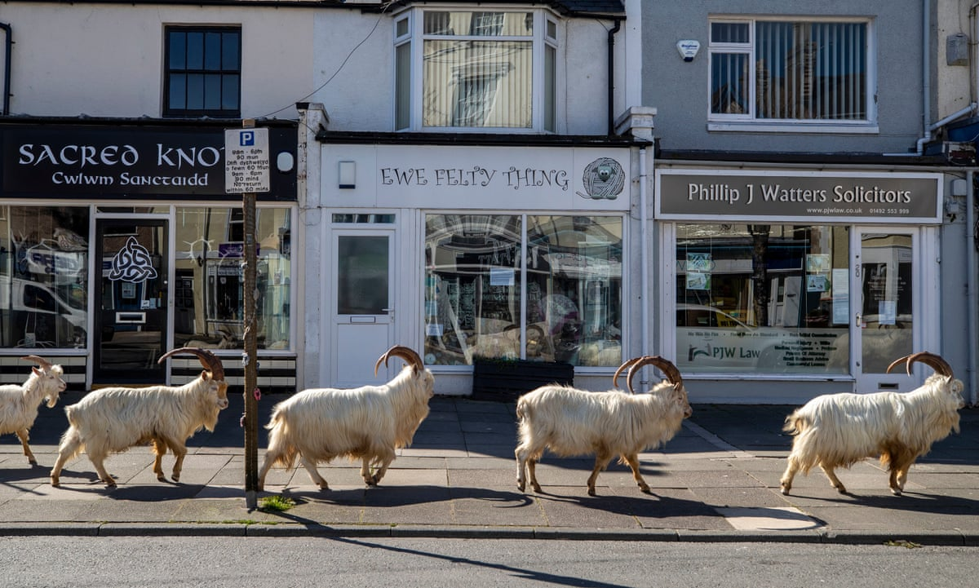

Slide 10
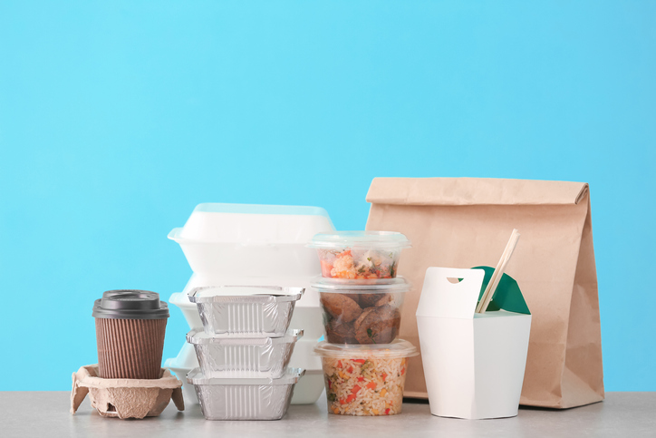

Slide 11
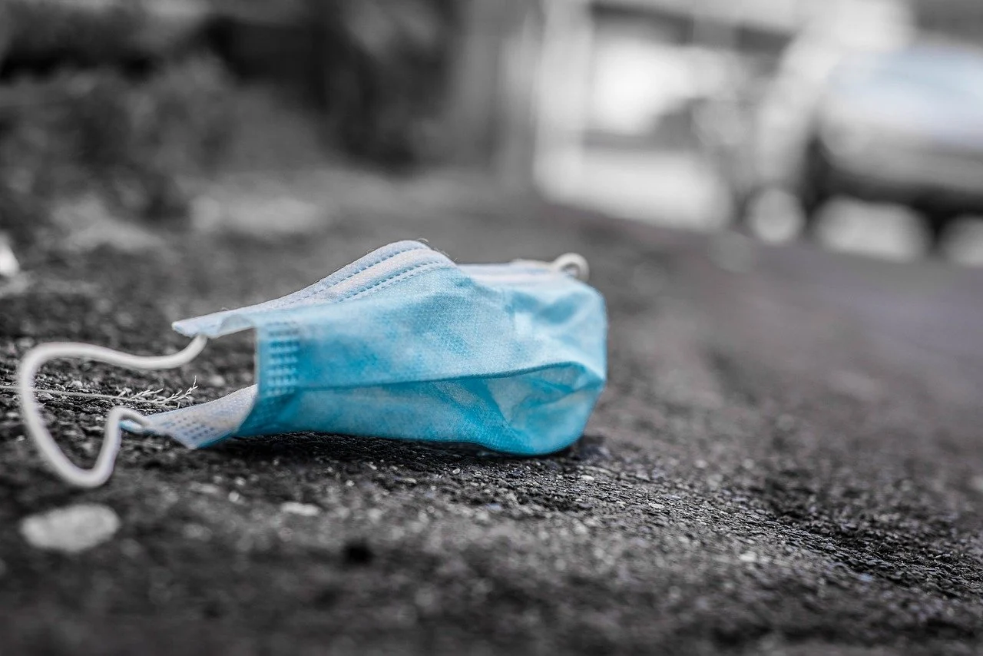
54%
concerned about damage to the environment due to COVID-19
Notes:
Source: Datassential’s COVID Report 6.10.20

Slide 12
+73%
GRASSFED BEEF
sales vs yr ago
7X
growth in
RECYCLABLE
product sales
12X
growth in
ETHICAL
product sales
22X
growth in
RECYCLABLE PACKAGING
product sales
4X
growth in
HUMANELY RAISED
product sales
Notes:
Source: IRI insights: navigating covid-19 and the path ahead, July 2020
Look at information Catherine send…study (maybe in notes)…comment from researcher – “consumers are now looking at and will be loyal to companies that show their care for environment and communities…putting money where heart is”

Slide 13
TAKING CARE OF ME/ OTHERS

Slide 15
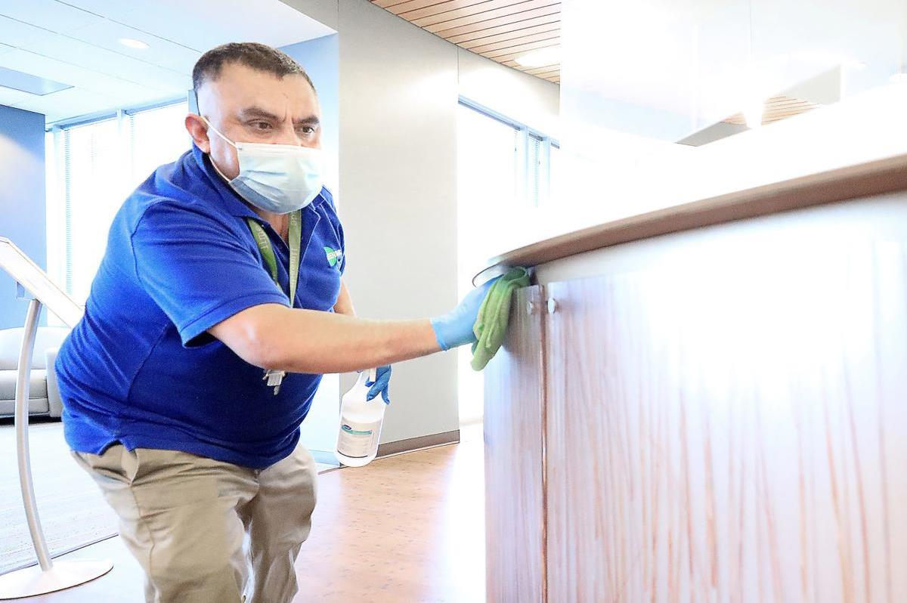

Slide 16
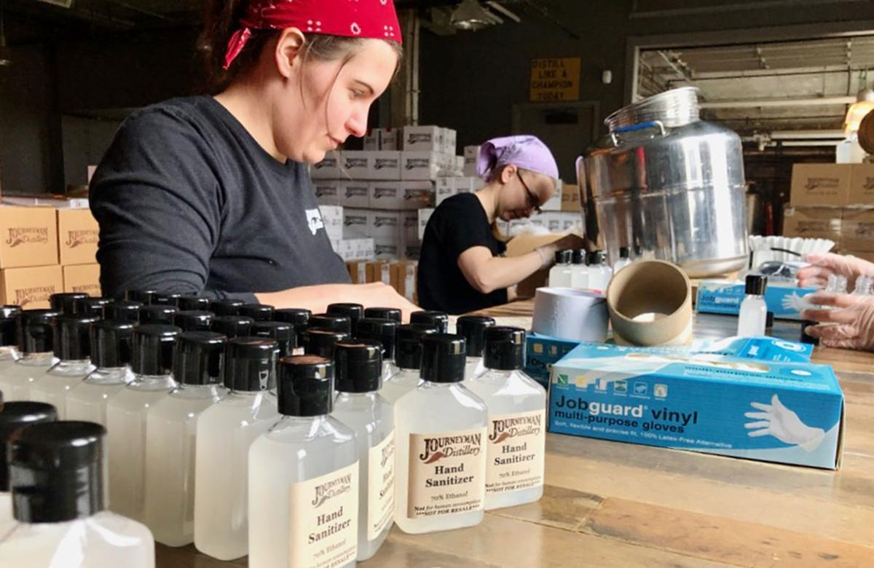

Slide 17
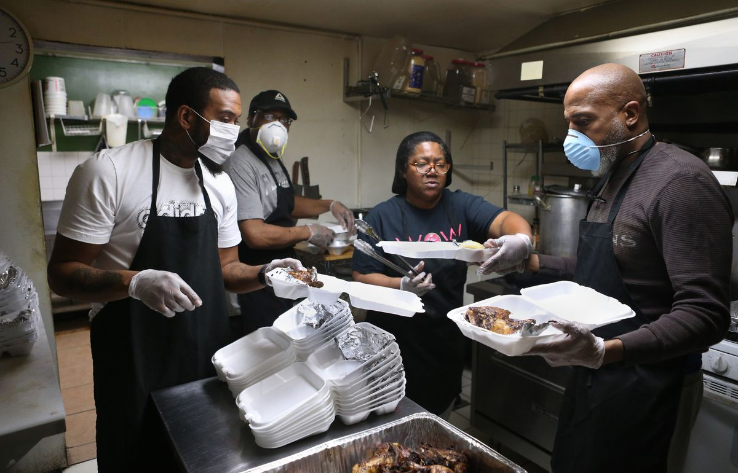

Slide 19
38%
currently boycotting at least one company
Notes:
CompareCards – up from 26% in January 2020

Slide 20
60%
spending more time on self care
Notes:
Accenture May 2020

Slide 21
NEW BEHAVIORS/ NEW SOLUTIONS

Slide 23
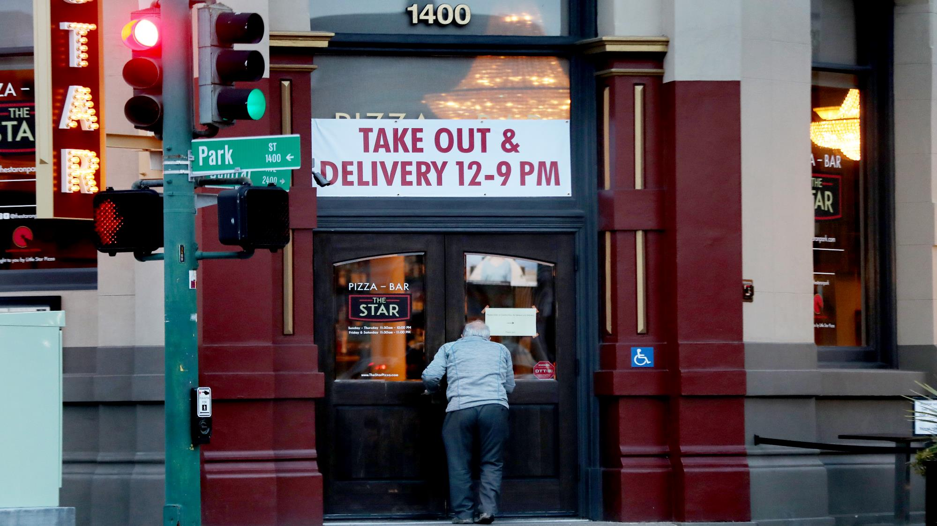
77%
trying new shopping behaviors – methods, brands, venues
Notes:
McKinsey 8.28.2020 survey

Slide 24
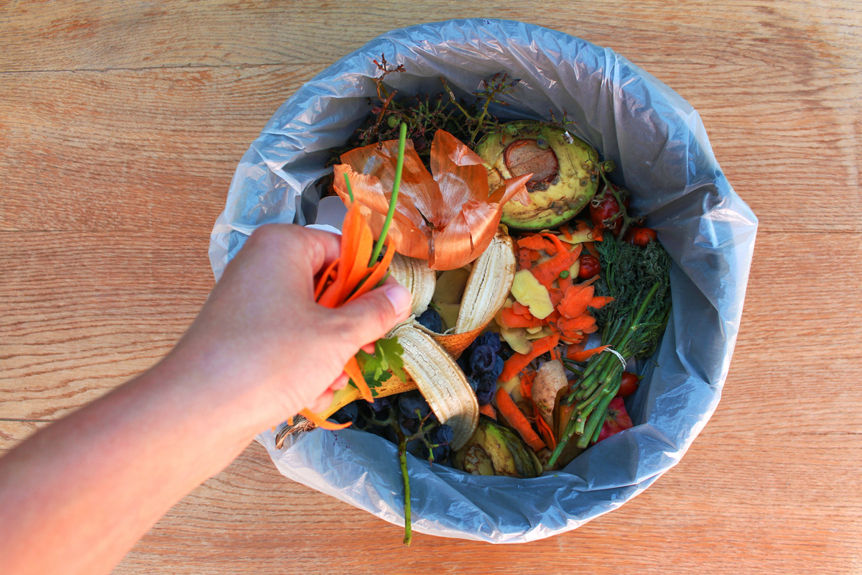
64%
focusing more on limiting food waste and will continue to do so
45%
making sustainable choices and will continue to do so
Notes:
McKinsey 8.28.2020 survey

Slide 25
MARKETING INNOVATION TO ADDRESS PAIN POINTS
Notes:
Weave consistency of supply into the overall conversation to support the second of the two main pillars (why Australia)
**Audience is strategists of brands…6-12 months to 5 year strategic plans so tactical/ operational-focused issues are important
People are looking for the CSR aspect in a tangible way

Slide 26
Position your choices to meet consumer concerns today and into the future
Focus on innovation that solves for patron + operational pain points
Communicate your efforts proudly, consistently and widely – illustrate your concern for guest experience
Notes:
Position your choices to meet consumer concerns:
Sustainability – products + ingredients with credentials + story
Nutrition/health – menu builds that meet health goals + health forward ingredients
Focus on innovation
It can mean a win for both the business and guests
From BOH (eg: strategic supply chain partners with ready-to-use products – saves labor + time + increases consistency etc) to FOH protocols (safety + sanitation)
Communicate your efforts
Your menu is a direct reflection of your brand and the #1 way to tell patrons your story – use it to highlight your choices within the dish descriptions as well as on other menu real estate (eg; supply blurbs)
Consider other avenues for how, where and when you communicate – traditional, social, member emails, in restaurant signage, etc

Slide 27
How does Aussie beef + lamb fit in?
Environmental commitment
Consistent year round supply
High quality lifetime traceable
LAMB
Delivers on unique + premium dining experiences
GRASSFED BEEF
Leverages health cues
Evokes a story of sustainability + care

Slide 28
Work with your mates!
INNOVATION
PUBLIC RELATIONS
TRAINING & EDUCATION
RESEARCH & INSIGHTS
PROMOTION
MENU DEVELOPMENT
Notes:
We’re here for you, and love to do this kind of collaboration. If you’re already using Aussie meats, or are keen to start, all of these tools at are your service.

Slide 29
Stay in touch, stay informed
www.trueaussiebeefandlamb.com | /aussiebeeflamb
#BeAussome | #chefsloveaussiebeef | #chefsloveaussielamb
Notes:
And of course, shameless plug – we’d love to stay in touch with you as you move through these trying times – we are ready when you are with education, inspiration and support for a dynamic hotel and lodging F&B experience.

Slide 30
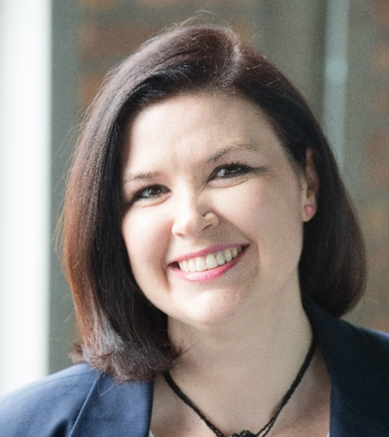
Questions? Get in touch direct…
Catherine Golding
E: cgolding@mlana.com
Maeve Webster
E: menumattersnow@gmail.com

